Slide 1

thank you all
as always
Notes:
thank you for not dropping the class:)
truly appreciate your support

Slide 2
Fundamentals of Computer Design - Basics
02
Kai Bu
kaibu@zju.edu.cn
http://list.zju.edu.cn/kaibu/comparch2019
Notes:
In today’s lecture, we will warm up with computer design basics

Slide 3
Fundamentals of Computer Design - Basics
which types of computers?
why are computers so fast?
what is computer architecture?
Notes:
such as computer classes, major techniques for fast computation, and the definition of computer architecture.
Only after we know in what ways we are evaluating computer performance can we know what to guarantee and improve upon designing computer architecture

Slide 4

too many
concepts ahead
Notes:
An overview chapter, so many concepts to unfold

Slide 5
What types of computers?
Notes:
Since all our discussions in this course will relate to computers, then what kinds/types of computers do you know or have? Any examples?

Slide 6
5 Classes of Computers
PMD: Personal Mobile Device
Desktop
Server
Cluster/WSC (warehouse-scale computer)
Embedded computer
Notes:
Good examples; All those computers you’ve just mentioned fall into these five classes.
The first one is personal mobile device.

Slide 7
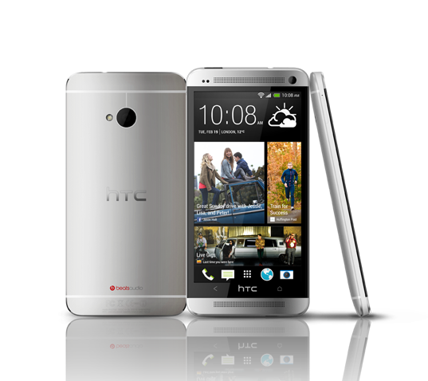
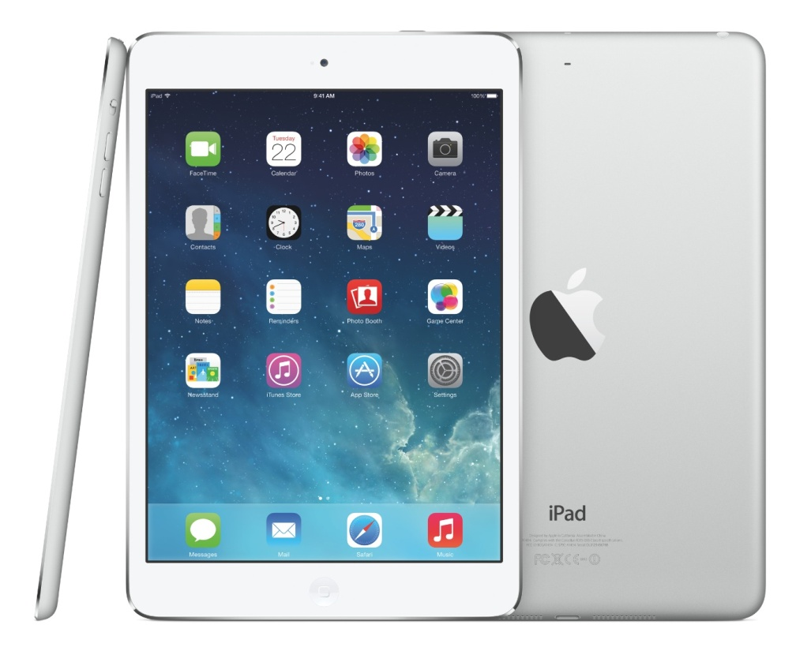
PMD: Personal Mobile Device
Wireless devices with multimedia user interfaces
cell phones, tablet computers, etc.
a few hundred dollars
Notes:
Personal mobile devices, such as smartphones and tablets, are the most pervasive computers nowadays.
They have small size, high portability, yet low cost.

Slide 8
PMD Characteristics
Cost effectiveness
less expensive packaging
absence of fan for cooling
Notes:
In comparison with more expensive computers like pcs or laptops,
PMD’s low cost owes to their less expensive packaging and absence of fan for cooling.

Slide 9
PMD Characteristics
Responsiveness & Predictability
real-time performance:
a maximum execution time for each
application segment
Notes:
The expectation for PMD’s responsiveness is that it should satisfy real-time performance constraint.
For this, a segment of the application has an absolute maximum execution time.
For example, in plying a video on a PMD, the time to process each video frame should be limited, since the processor must accept and process the next frame shortly.
However, real-time performance is a very strict requirement; it’s hard to satisfy.

Slide 10
PMD Characteristics
Responsiveness & Predictability
real-time performance:
a maximum execution time for each
application segment
soft real-time:
trade time of a certain event for others’;
tolerate occasionally missed time constraint on an event,
as long as not too many are missed;
Notes:
As an alternative, some applications choose soft real-time performance,
which tolerates occasionally missed time constraint on an event, as long as not too many are missed.

Slide 11
PMD Characteristics
Memory efficiency
optimize code size
Energy efficiency
battery power
heat dissipation
Notes:
For PMD, Memory can be a substantial portion of the system cost; We need to economize memory usage. PMD hosts various applications and thus large volume of code; so we can optimize code size towared memory efficiency;
Besides, PMD also has limited power and has no fan for cooling; so economizing battery usage and heat dissipation technique are key to save energy;

Slide 12
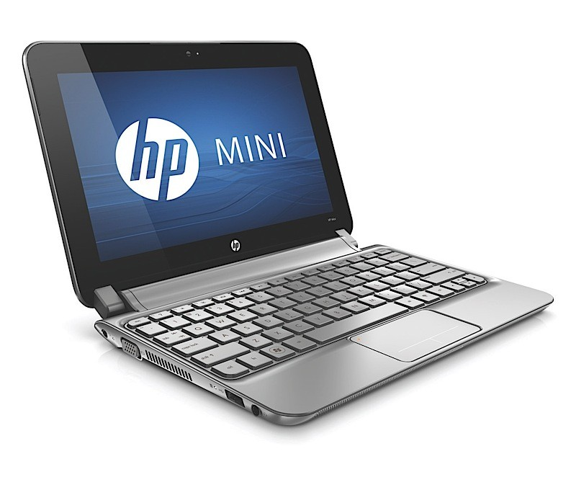
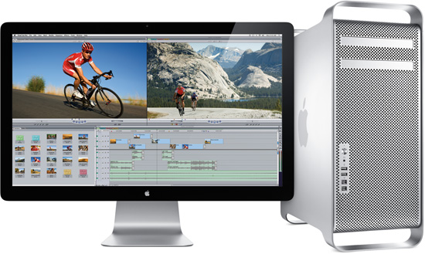
Desktop Computing
Largest market share
low-end netbooks: $x00
high-end workstations: $x000
Notes:
Desktops and laptops take largest market share and are most familiar to us.
They range from low-end netbooks to high-end workstations.
They usually cost hundreds to thousands of dollars

Slide 13
Desktop Characteristics
Price-Performance
combination of performance and price;
compute performance
graphics performance
The most important to customers,
and hence to computer designers
Notes:
Desktops deliver high performance but cost affordable prices.
So they are the most important to customers and hence to computer designers.

Slide 14
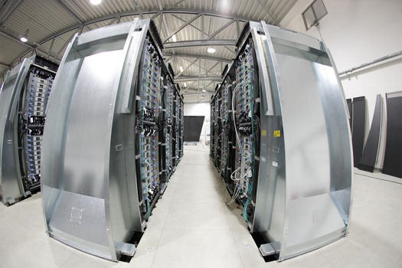
Servers
Provide large-scale and reliable file and computing services (to desktops)
Constitute the backbone of large-scale enterprise computing
Notes:
Servers aim to provide large-scale and reliable file and computing services to desktops connected to them.
They constitute the backbone of large-scale enterprise computing.

Slide 15
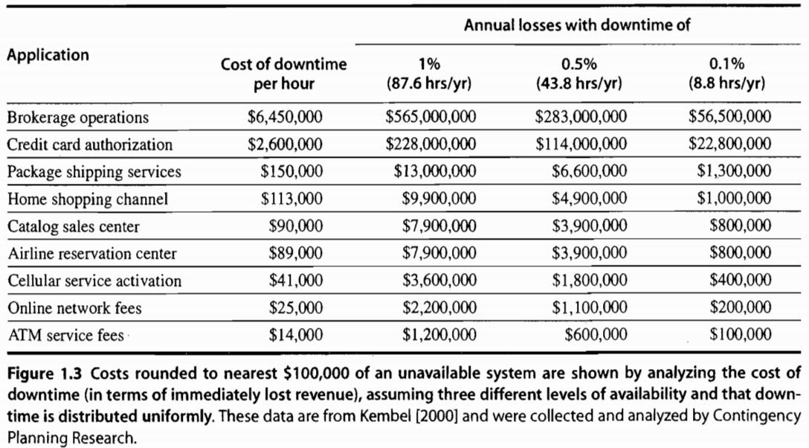
Servers Characteristics
Availability
against high-cost server failure
Notes:
The major character of servers should be high availability, as server down usually costs a lot to hosting services.
For some critical network services like credit card authentication and ATM operations, server failure comes at too high a cost.

Slide 16
Servers Characteristics
Scalability
in response to increasing demand with scaling up computing capacity, memory, storage, and I/O bandwidth
High throughput
handling more requests in a unit time
Notes:
Servers should also be scalable, that is, they should be capable of handling a large volume of service requests.
Toward this, it might need to enhance computing and storage capacity.
We also expect that servers have high throughput, that is, handling more requests in a unit time.

Slide 17

Clusters/WSCs
Warehouse-Scale Computers
collections of desktop computers or servers
connected by local area networks (LANs)
to act as a single larger computer
Characteristics
price-performance, availability, power
Notes:
Clusters are also known as werehouse-scale computers; they are collections of pcs/servers
Then the connected computers can act as a single larger computer.
Its Characteristics are similar to its components, that is, desktop and server: which are, for example, price-performance and availability
Besides, since it consists of a bunch of computers altogether, we need to economize its power consumption;

Slide 18
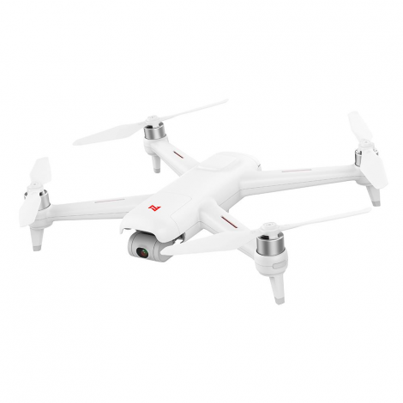
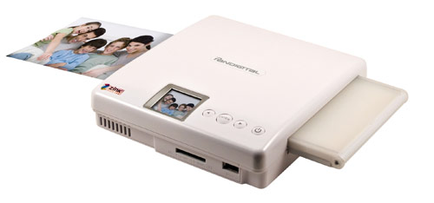
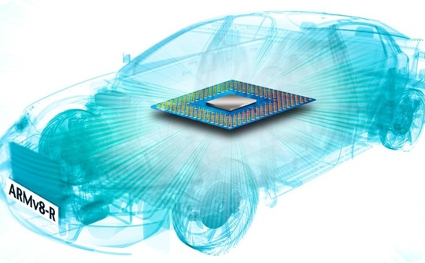
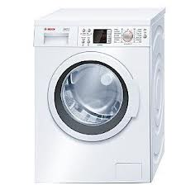
Embedded Computers
hide everywhere
Notes:
Embedded computers just hide everywhere. They are in cameras, washing machines, drones, and even our cars.

Slide 19
Embedded vs Non-embedded
Dividing line:
the ability to run third-party software
Embedded computers’ primary goal:
meet the performance need at a minimum price;
rather than achieve higher performance at a higher price
Notes:
How can we differ embedded computers from non-embedded ones?
The key clue is whether a computer got the ability to run third-party software.
After all, embedded computers are made to meet the performance need at a minimum price
rather than achieve higher performance at a higher price.
Any questions?

Slide 20
What makes computers fast?
Notes:
What makes these types of computers so fast?
Any ideas?

Slide 21
Parallelism
Multi-task simultaneously takes effect
application parallelism
hardware parallelism
Notes:
The answer is parallelism, it makes multiple tasks to simultaneously take effect;
We can explore parallelism in both application layer and hardware layer.

Slide 22
Application Parallelism
DLP: Data-Level Parallelism
many data items being operated on
at the same time
TLP: Task-Level Parallelism
tasks of work created to operate independently and largely in parallel
*parallelization across multiple processors
in parallel computing environments
Notes:
For application parallelism, we have data-level parallelism and task-level parallelism.
DLP operates many data items at the same time; (example: addition computation)
TLP creates tasks of work such that they operate independently and largely in parallel.
Both parallelisms strive for parallelization across multiple processors in parallel computing environments

Slide 23
Application Parallelism
DLP: Data-Level Parallelism
many data items being operated on
at the same time;
distribute the same data across different processors;
Notes:
Essentially, DLP focuses on distributing the data across different processors, which operate on the data in parallel.

Slide 24
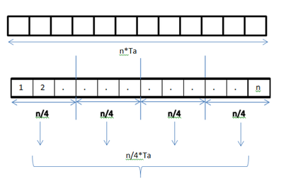
Application Parallelism
DLP: Data-Level Parallelism
many data items being operated on
at the same time;
distribute the same data across different processors;
Example 1:
add elements in an array;
each addition takes Ta time units;
1 processor vs 4 processors

Slide 25
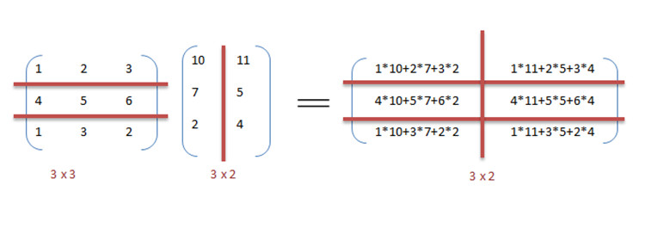
Application Parallelism
DLP: Data-Level Parallelism
many data items being operated on
at the same time;
distribute the same data across different processors;
Example 2:
matrix
multiplication
1 processor vs 6 processors

Slide 26
Application Parallelism
TLP: Task-Level Parallelism
tasks of work created to operate independently and largely in parallel;
run many different tasks at the same time on the same data;
Example:
input a bitstring to two processors;
processor A counts bit 0 or 1;
processor B computes its complement;
Notes:
In contrast to data level parallelism that runs the same task on different components of data, TLP runs many different tasks at the same time on the same data.

Slide 27
Hardware Parallelism
Hardware exploits app parallelism
in four ways:
ILP: Instruction-Level Parallelism
Vector Architectures and GPUs
TLP: Thread-Level Parallelism
RLP: Request-Level Parallelism
Notes:
For hardware parallelism, we have four possible ways.
The first one is instruction-level parallelism.

Slide 28
Hardware Parallelism
ILP: Instruction-Level Parallelism
exploits data-level parallelism
at modest levels – pipelining
divide a task to steps;
simultaneously run different steps
of different tasks.
at medium levels – speculative execution
do some work in advance;
prevent delay when the work is needed.
Notes:
Instruction-level parallelism exploits data-level parallelism;
At modest levels, it works through pipelining. Pipelining is the most important topic of our lecture and lab sessions.
It divides a task to steps, and then simultaneously runs different steps of different tasks.
At medium levels, instruction-level parallelism works through speculative execution. It runs some task in advance in order to prevent delay when the task’s result is needed.

Slide 29
Hardware Parallelism
Vector Architectures & GPUs
(Graphic Process Units)
exploit data-level parallelism;
apply a single instruction to a collection of data in parallel;
Notes:
Vector architectures and GPUs also exploit data-level parallelism; it applies a single instruction to a collection of data in parallel.

Slide 30
Hardware Parallelism
TLP: Thread-Level Parallelism
exploits either DLP or TLP,
in a tightly coupled hardware model
that allows for interaction among parallel threads;
Notes:
On the other hand, thread-level parallelism exploits either data-level parallelism or task-level parallelism.
It aims for tightly coupled hardware model that allows for interaction among parallel threads.

Slide 31
Hardware Parallelism
RLP: Request-Level Parallelism
exploits parallelism among
largely decoupled tasks
specified by the programmer or the OS
Notes:
Finally, request-level parallelism exploits parallelism among largely decoupled tasks specified by the programmer or the operating system.

Slide 32
Classes of Parallel Architectures
by Michael Flynn
Single/Multiple Instruction/Data stream
SISD
SIMD
MISD
MIMD
Notes:
According to the number of instruction stream and data stream under use, parallel architectures can be classified into four types.
Each may work on single or multiple instruction stream and single or multiple data stream.

Slide 33
SISD
Single instruction stream,
single data stream
uniprocessor
Exploit instruction-level parallelism
Notes:
SISD works on single instruction stream and single data stream.
It can exploit only instruction-level parallelism.

Slide 34
SIMD
Single instruction stream,
multiple data stream
The same instruction is executed by multiple processors using different data streams.
Exploits data-level parallelism
Data memory for each processor;
whereas a single instruction memory and control processor.
Notes:
SIMD works on single instruction stream and multiple data stream.
Specifically, the same instruction is executed by multiple processors using different data streams. it thus exploits data-level parallelism.
Each processor has a data memory of its own, while all processors share a single instruction memory.

Slide 35
MISD
Multiple instruction streams,
single data stream
hard to exploit data-level parallelism
No commercial multiprocessor of this type yet
Notes:
MISD works on Multiple instruction streams and a single data stream
As you may notice, it’s hard to exploit data-level parallelism for misd, so there’s no such type of commercial multiprocessor yet;

Slide 36
MIMD
Multiple instruction streams,
multiple data streams
Each processor fetches its own instructions and operates on its own data.
Exploits task-level parallelism
Notes:
MIMD works on multiple instruction streams and multiple data streams.
Each processor fetches its own instructions and operates on its own data.
It exploits task-level parallelism.

Slide 37
What’s computer architecture?
Notes:
We’ve discussed about computer basics and parallelism it can leverage for fast task execution;
Then what exactly is computer architecture?

Slide 38
Computer Architecture
Refer only to instruction set design
Notes:
The term computer architecture is used to refer to instruction set design.

Slide 39
What’s instruction set architecture?
Notes:
So first, we need to understand what is instruction set architecture.

Slide 40
Instruction Set Architecture
ISA
programmer-visible instruction set
the boundary between software and hardware
Notes:
Instruction set architecture is called ISA for short.
It’s visible to programmers and serves as the boundary between software and hardware.

Slide 41
ISA: Class
Most are general-purpose register architectures with operands of either registers or memory locations
Two popular versions
register-memory ISA: e.g., 80x86
many instructions can access memory
load-store ISA: e.g., ARM, MIPS
only load and store instructions can access memory
Notes:
Most instruction set architectures are general-purpose register architectures.
Their operands are either registers or memory locations.
Tow popular versions of general-purpose register architectures are register-memory ISA and load-store ISA.
80 ex 86 belongs to register-memory ISA. It allows many instructions to access memory.
ARM and MIPS belong to load-store ISA. It allows only load and store instructions to access memory.

Slide 42
ISA: Memory Addressing
Byte addressing
Aligned address
object width: s bytes
address: A
aligned if A mod s = 0
Notes:
Memory addressing is the procedure when an instruction finds its interested data at a certain location in memory.
The smallest unit for how much volume of data can be accessed at one time is one byte.
When storing data in memory, we require that their addresses be aligned.
Given object width s and address A, for its address to be aligned, we should have that A modulo s equals to zero.

Slide 43
Why alignment?
Notes:
Then why need we follow address alignment?

Slide 44
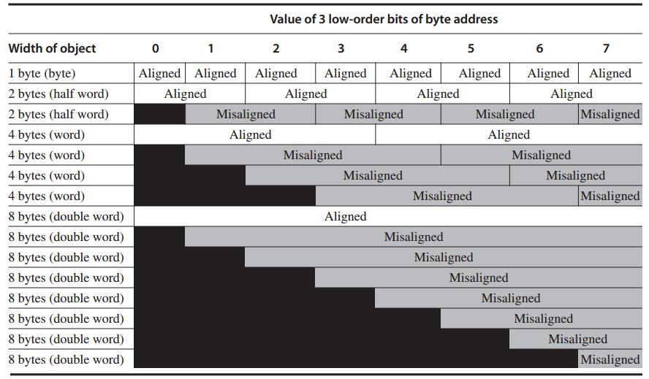
Each misaligned object requires two memory accesses
Notes:
This picture clearly demonstrates that address alignment helps limit memory access times.
When well aligned, requires only on memory access to read one object;
If address is not well aligned, each misaligned object requires two memory accesses to fetch.

Slide 45
ISA: Types and Sizes of OPerands
Type | Size in bits
ASCII character | 8
Unicode character Half word | 16
Integer word | 32
Double word Long integer | 64
IEEE 754 floating point – single precision | 32
IEEE 754 floating point – double precision | 64
Floating point – extended double precision | 80
Notes:
Here’s an overview of types and sizes of instruction perands.

Slide 46
ISA: Addressing Modes
Specify the address of a memory object (as operands of instructions):
Register, Immediate, Displacement
constant
register + constant
Notes:
An instruction has three addressing modes for it to specify the address of a memory object as one of its operands.
The operand could be a register, an immediate, or a displacement.
For register, the operand is just the name/alias of the register.
for immediate, it’s a constant which directly points to the memory address/location.
For displacement, it specifies a register in addition to a constant, then we need to add the constant to the value stored in the register, the result is the corresponding memory address.

Slide 47
ISA: Operations
Four general categories
data transfer
arithmetic logical
control
floating point
Notes:
With an instruction, we could achieve one of the following four categories of operations:
They are data transfer operation, arithmetic logical operation, control operation, floating point operation;

Slide 48
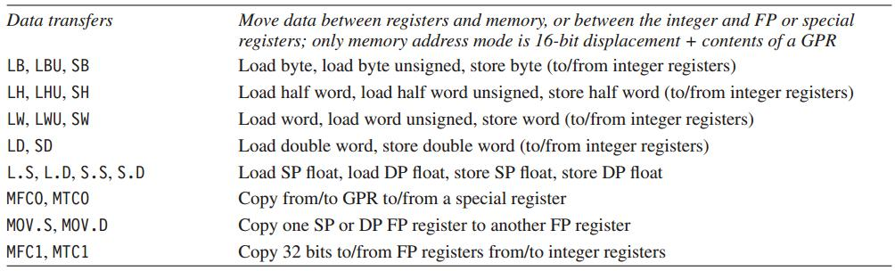
MIPS64 Operations
Data transfer
Notes:
The tables list example instructions of each operation type.

Slide 49
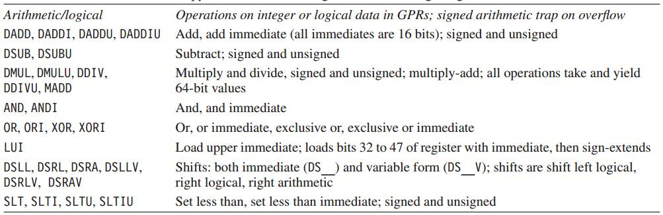
MIPS64 Operations
Arithmetic Logical

Slide 50
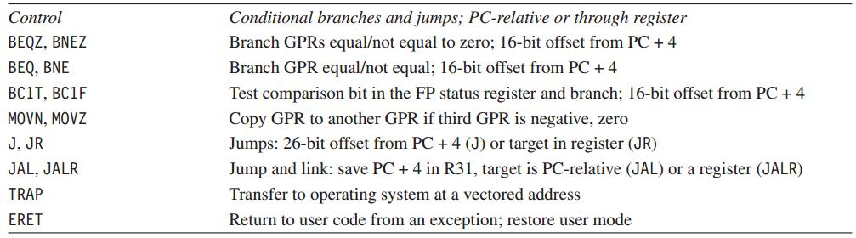
MIPS64 Operations
Control

Slide 51
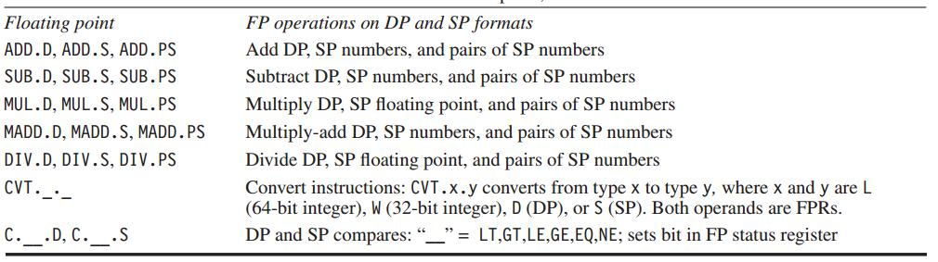
MIPS64 Operations
Floating point

Slide 52
ISA: Control Flow Instructions
Types:
conditional branches
unconditional jumps
procedure calls
returns
Branch address: add an address field to PC (program counter)
Notes:
Control instructions also have various types; and each type has its own way to specify the next instruction to run;
We’ll discuss more about them in later lecture sessions.

Slide 53
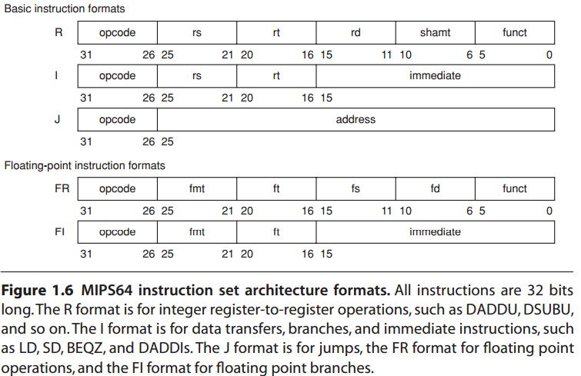
ISA: Encoding an ISA
Fixed length: ARM, MIPS – 32 bits
Variable length: 80x86 – 1~18 bytes
http://en.wikipedia.org/wiki/MIPS_architecture
https://inst.eecs.berkeley.edu/~cs61c/resources/MIPS_help.html
Start with a 6-bit opcode. R-type: register three registers, a shift amount field, and a function field; I-type: immediate two registers, a 16-bit immediate value; J-type: jump a 26-bit jump target.
Notes:
As we mentioned, instructions should be encoded in a format understandable to computer hardware, right?
Here are various possible types of instruction formats.
Again, we’ll detail them in later chapters.
R type: rs, rt – the first and second operand; rd – destination register
MIPS reference sheet: https://inst.eecs.berkeley.edu/~cs61c/resources/MIPS_help.html

Slide 54
Again, what’s computer architecture?
Notes:
Now, putting all together, let’s again more comprehensively define computer architecture.

Slide 55
Computer Architecture
ISA
Organization
Hardware
actual programmer
visible instruction set;
boundary between sw
and hw;
high-level aspects
of computer design:
memory system,
memory interconnect,
design of internal processor or CPU;
computer specifics:
logic design,
packaging tech;
Notes:
it actually covers all three aspects of computer design: instruction set architecture, organization (or microarchitecture), and hardware;

Slide 56
Computer Architecture
ISA
Organization
Hardware
actual programmer
visible instruction set;
boundary between sw
and hw;
high-level aspects
of computer design:
memory system,
memory interconnect,
design of internal processor or CPU;
computer specifics:
logic design,
packaging tech;
Computer architects must design the organization and hardware
to meet functional requirements
as well as price, power, performance, and availability goals.
Notes:
In summary, computer architects must design the organization and hardware to meet functional requirements as well as price, power, performance, and availability goals.

Slide 57
Review
5 classes of computers
Parallelism
Instruction set architecture
Computer architecture

Slide 58
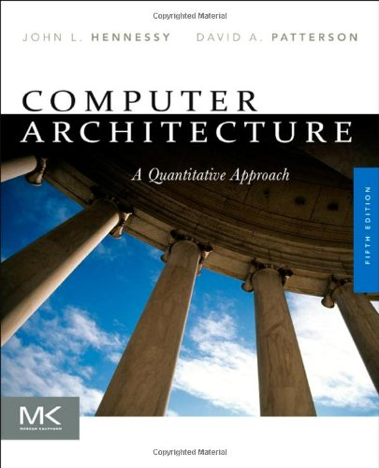
Chapter 1.1-1.3
Notes:
The contents discussed can be found in the first part of Chapter 1.

Slide 59
Lab 1
Demo Due: September 30, 2019
Report Due: October 12, 2019
Reference

Slide 60
Assignment 1
link
10 min presentation per group
October 12, 08:00 – 12:15
Room 502, CGB Building East Wing
Bonus
tbd…for the best presentation group
Suggestions? Make it fun!

Slide 61
?

Slide 62
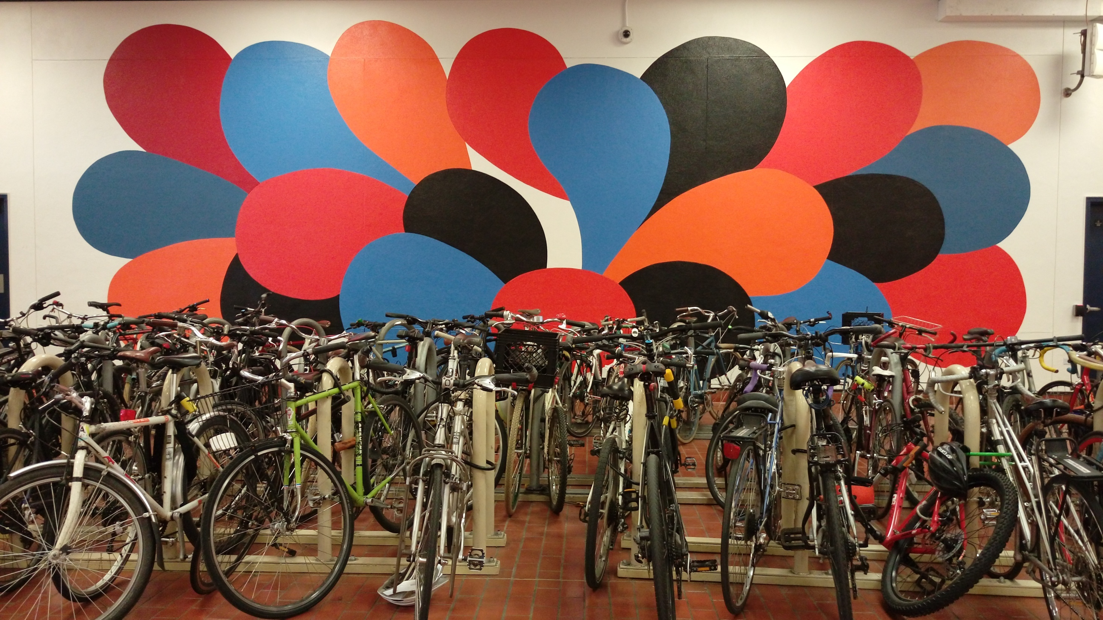
Thank You
be on the road
Notes:
Run your own race.

Slide 63
#What’s More
If you can dream it, you can accomplish it.
What's Your Dream by LinkedIn
If not now, when?
The 3 Secrets of Highly Successful Graduates by Reid Hoffman

Slide 64
#What’s More
The Meaning of Teaching… A Long Thank You Note
by Kai Bu
Notes:
With our mutual efforts, let’s engage more in this class so that we can really ENJOY the teaching and learning process.

